Slide 1
Comparative Transcriptomics
Ostrea lurida
Haliotis kamtschatkana

Slide 2
Comparative Transcriptomics
Ostrea lurida
Haliotis kamtschatkana

Slide 3
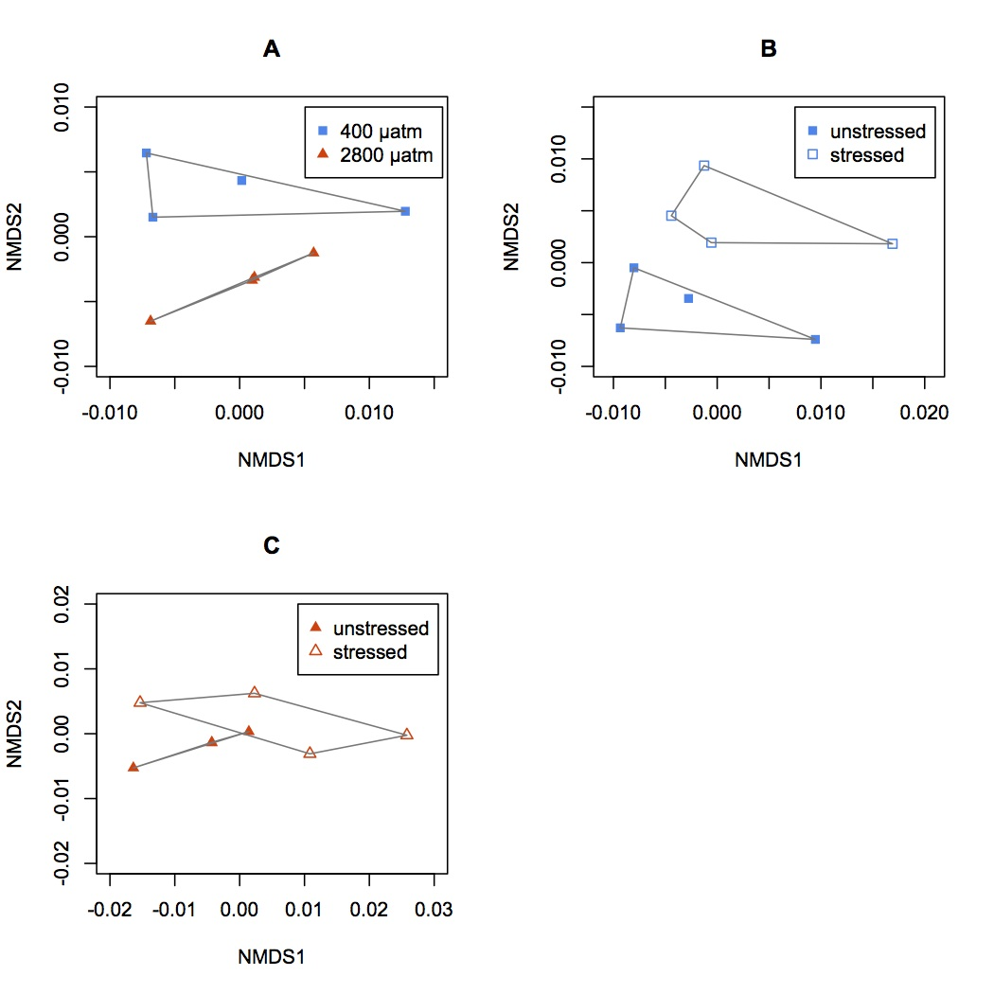
Oyster Proteomics

Slide 4
Oyster Proteomics
2800 µatm
400µatm

Slide 5
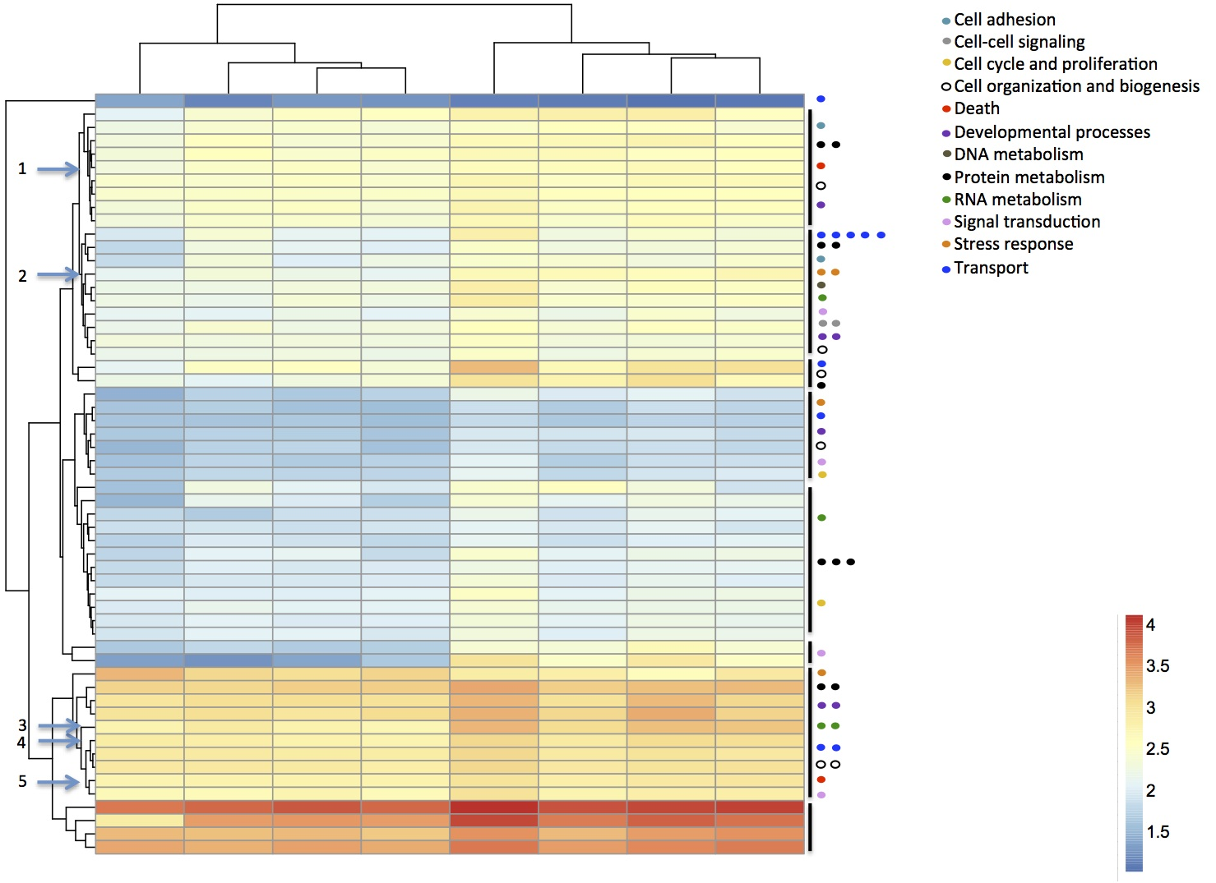
2800 µatm
400µatm

